Slide 1

IT5002
Computer Systems and Applications
Lecture 12
Process Management
colintan@nus.edu.sg

Slide 2
Introduction
In this lecture we will look at:
The difference between a program and a process.
Interrupts and How They Work
Process States.
How to run Multiple Processes in a Single CPU
Process Creation, termination and zombies.

Slide 3
Program vs. Process
A program consists of:
Machine instructions (and possibly source code).
Data
A program exists as a file on the disk. E.g. command.exe, winword.exe
A process consists of:
Machine instructions (and possibly source code).
Data.
Context
Exists as instructions and data in memory.
MAY be executing on the CPU.

Slide 4
Program vs. Process
A single program can produce multiple processes.
E.g. chrome.exe is a single program.
But every tab in Chrome is a new process!

Slide 5
Interrupts
When a device needs attention from the CPU, it triggers what is called an “interrupt”:
Each device is connected to the CPU via an input called an “Interrupt Request” or IRQ line.
When a device needs attention, it pulls the IRQ line HIGH or LOW (depending on whether line is “active high” or “active low”)

Slide 6
Interrupts
This line is checked at the end of the WB stage in the CPU Execution Cycle.
Diagrams below show the CPU’s program execution flow when an interrupt occurs:

Slide 7
Execution Modes
Programs usually run sequentially.
Each instruction is executed one after the other.
Having multiple cores or CPUs allow parallel (“concurrent”) execution.
Streams of instructions with no dependencies are allowed to execute together.
A multitasking OS allows several programs to run “concurrently”.
Interleaving, or “time-slicing”.

Slide 8
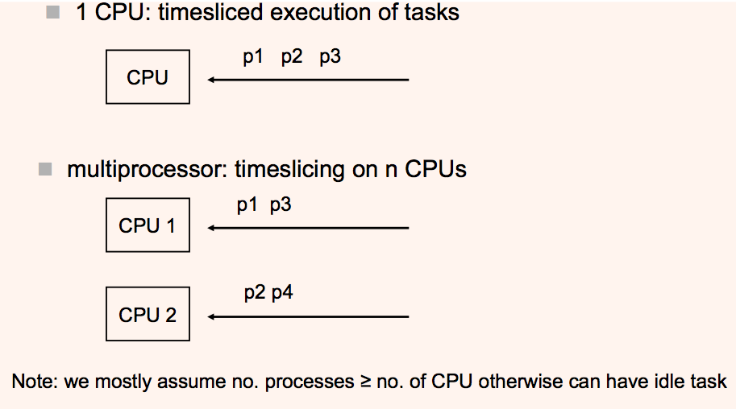
Execution Modes

Slide 9
Processes and process management
Task Management

Slide 10
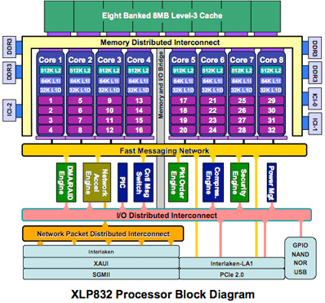
The Process Model
In this lecture we will assume a single processor with a single core.
This is a legitimate assumption because in general the number of processes >> the number of cores.
So each core must still switch between processes.

Slide 11
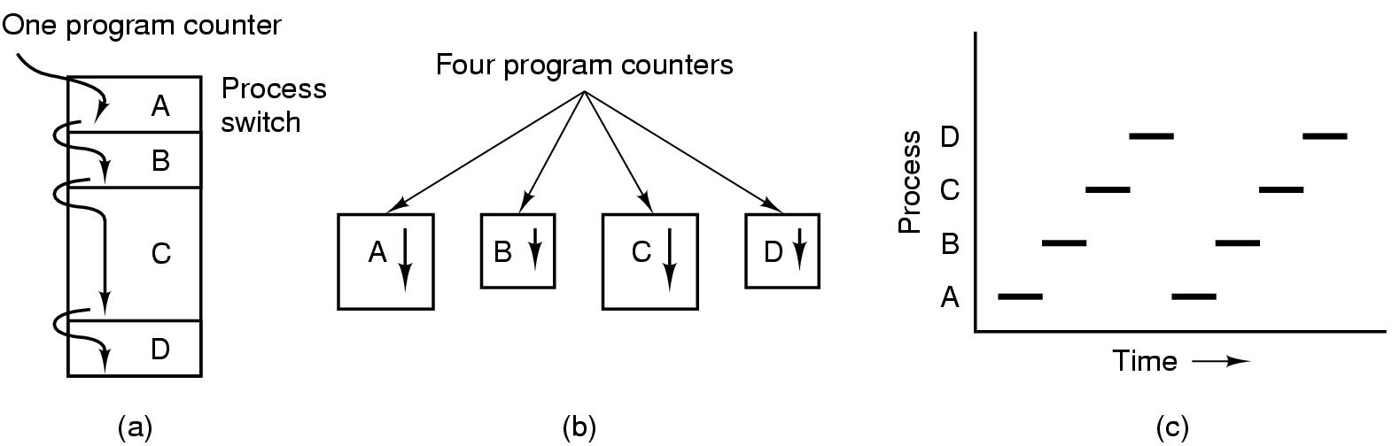
The Process Model
Since we have only a single-core single processor:
At any one time, at most one process can execute.
Figures (a) to (c) below illustrate what happens:

Slide 12
The Process Model
Figure (b) shows what “appears” to be happening in a single processor system running multiple processes:
There are 4 processes each with its own program counter (PC) and registers.
All 4 processes run independently of each other at the same time.

Slide 13
The Process Model
Figure (a) shows what actually happens.
There is only a single PC and a single set of registers.
When one process ends, there is a “context switch” or “process switch”:
PC, all registers and other process data for Process A is copied to memory.
PC, register and process data for Process B is loaded and B starts executing, etc.
Figure (c) illustrates how processes A to D share CPU time.

Slide 14
Process States
A process can be in one of 3 possible states:
Running
The process is actually being executed on the CPU.
Ready
The process is ready to run but not currently running.
A “scheduling algorithm” is used to pick the next process for running.
Blocked.
The process is waiting for “something” to happen so it is not ready to run yet.
E.g. include waiting for inputs from another process.

Slide 15
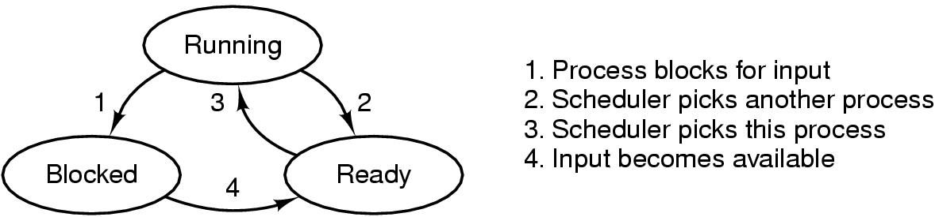
Process States
The diagram below shows the 3 possible states and the transitions between them.

Slide 16
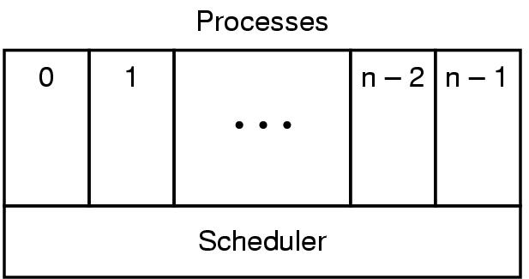
Process States
The figure below shows how the processes are organized.
The lowest layer selects (schedules) which process to run next.
This is subject to “scheduling policies” which we will look at in a later lecture.

Slide 17
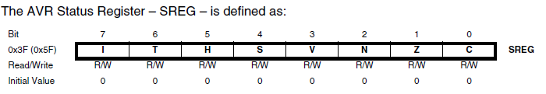
Switching between Processes
When a process runs, the CPU needs to maintain a lot of information about it. This is called the “process context”.
CPU register values.
Stack pointers.
CPU Status Word Register.
This maintains information about whether the previous instruction resulted in an overflow or a “zero”, whether interrupts are enabled, etc.
This is needed for branch instructions – assembly equivalents of “if’ statements.

Slide 18
Switching between Processes
All of these values change as a process runs.
When a process is blocked or put into a READY state, a new process will be picked to take control of the CPU.
All the information for the current process must be saved!
The information for the new process must be loaded into the registers, stack pointer and status registers!
This is to allow the new process to run like as though it was never interrupted!
This process is known as “context switching”.

Slide 19
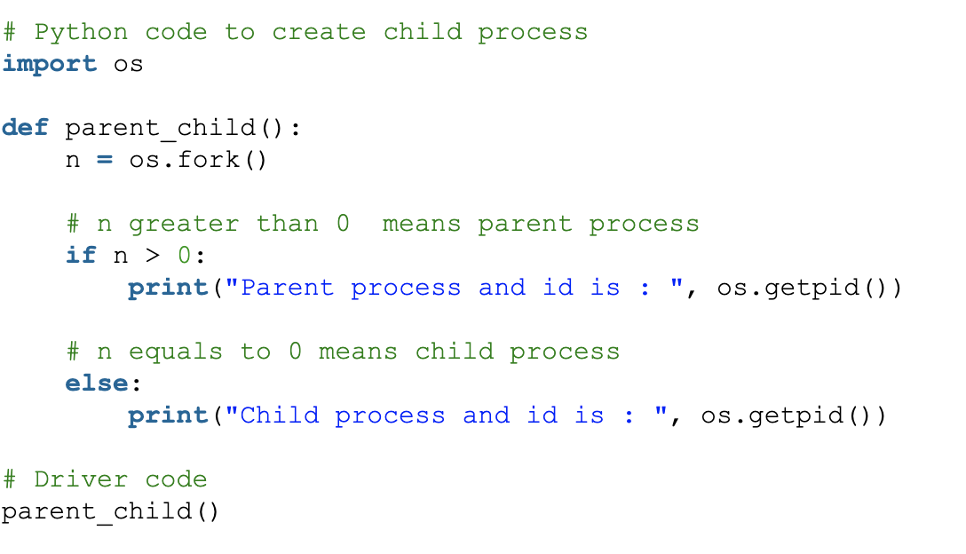
Process Creation
A process can be created in Python by using a fork() call:
The creating process is called a “parent” process, while the created process is called a “child” process.

Slide 20
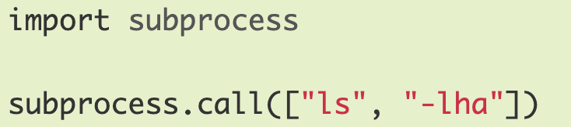
Process Creation
When you run a program in your OS shell, the shell uses the OS to create a new process, then run the program in the new process.
In Python this is done by using subprocess.call:
The launched is thus a child process of the shell.
Ultimately, all UNIX processes are children of “init”, the main starting process in UNIX.

Slide 21
Process Control Blocks
When a process is created, the Operating System also creates a data structure to maintain information about that process:
Called a “Process Control Block” (PCB) and contains:
Process ID (PID)
Stack Pointer
Open files
Pending signals
CPU usage
…
PCB is stored in a table called a “Process Table”.
One Process Table for entire system.
One PCB per process.

Slide 22
Terminating A Process
When a process terminates:
Most resources like open files, etc., can be released and returned to the system.
However the PCB is retained in memory:
Allows child processes to return results to the parent.
Parent retrieves the results using a “wait” function call, afterwhich the PCB is released.
What if the parent never calls “wait”?
PCB remains in memory indefinitely.
Child becomes a “zombie”. Eventually process table will run out of space and no new process can be created.

